Slide 1
PODCAST PLUS:A Redux-Inspired Podcast App with Dynamic Themes for A ndroid

Slide 2
DESCRIPTION
Podcast Plus: A Redux-Inspired Podcast App with Dynamic Themes for Android
Podcast Feed: Displays the latest episodes by genre or popularity, updated in real-time with Redux for smooth performance.
Episode Details: Each episode has a dedicated page showing title, description, duration, and play/pause options. Redux tracks actions for efficient handling.
Dynamic Themes: Choose light, dark, or custom themes without interrupting playback, thanks to Redux for seamless theme switching.
Offline Playback: Download episodes for offline listening, with Redux tracking downloads and syncing seamlessly when back online.
Playlists & Favorites: Users can create playlists of favorites, managed by Redux for effortless adding or removing of episodes.
Personalized Recommendations: Based on listening history, the app curates recommendations, using Redux to refine suggestions.
Real-Time Notifications: Redux manages alerts about new episodes or updates, keeping users informed and engaged.

Slide 3
SOURCE CODE
ConnectivityActionReceiver.kt:
package ac.mdiq.podcini.receiver
import ac.mdiq.podcini.net.download.service.DownloadServiceInterface
import ac.mdiq.podcini.net.utils.NetworkUtils.isAutoDownloadAllowed
import ac.mdiq.podcini.net.utils.NetworkUtils.isNetworkRestricted
import ac.mdiq.podcini.storage.algorithms.AutoDownloads.autodownloadEpisodeMedia
import ac.mdiq.podcini.util.Logd
import ac.mdiq.podcini.util.config.ClientConfigurator
import android.content.BroadcastReceiver
import android.content.Context
import android.content.Intent
import android.net.ConnectivityManager
import android.util.Log

Slide 4
class ConnectivityActionReceiver : BroadcastReceiver() {
override fun onReceive(context: Context, intent: Intent) {
Log.d(TAG, "onReceive called with action: ${intent.action}")
if (intent.action == ConnectivityManager.CONNECTIVITY_ACTION) {
Logd(TAG, "Received intent")
ClientConfigurator.initialize(context)
networkChangedDetected(context)
}
}
private fun networkChangedDetected(context: Context) {
if (isAutoDownloadAllowed) {
Logd(TAG, "auto-dl network available, starting auto-download")
autodownloadEpisodeMedia(context)
}

Slide 5
else {
if (isNetworkRestricted) {
Log.i(TAG, "Device is no longer connected to Wi-Fi. Cancelling ongoing downloads")
DownloadServiceInterface.get()?.cancelAll(context)
}
}
}
companion object {
private val TAG: String = ConnectivityActionReceiver::class.simpleName ?: "Anonymous"
}
}

Slide 6
FeedUpdateReceiver.kt:
package ac.mdiq.podcini.receiver
import android.content.BroadcastReceiver
import android.content.Context
import android.content.Intent
import ac.mdiq.podcini.util.config.ClientConfigurator
import ac.mdiq.podcini.net.feed.FeedUpdateManager
import ac.mdiq.podcini.util.Logd

Slide 7
class FeedUpdateReceiver : BroadcastReceiver() {
override fun onReceive(context: Context, intent: Intent) {
Logd(TAG, "Received intent")
ClientConfigurator.initialize(context)
FeedUpdateManager.runOnce(context)
}
companion object {
private val TAG: String = FeedUpdateReceiver::class.simpleName ?: "Anonymous"
}
}

Slide 8
MediaButtonReceiver.kt:
package ac.mdiq.podcini.receiver
import ac.mdiq.podcini.util.config.ClientConfigurator
import android.app.PendingIntent
import android.content.BroadcastReceiver
import android.content.Context
import android.content.Intent
import android.os.Build
import android.util.Log
import android.view.KeyEvent
import androidx.core.content.ContextCompat

Slide 9
class MediaButtonReceiver : BroadcastReceiver() {
override fun onReceive(context: Context, intent: Intent) {
Log.d(TAG, "onReceive Received intent: $intent")
Log.d(TAG, "onReceive Action: ${intent.action}")
val extras = intent.extras
Log.d(TAG, "onReceive Extras: $extras")
if (extras == null) return
Log.d(TAG, "onReceive Extras: ${extras.keySet()}")
for (key in extras.keySet()) {
Log.d(TAG, "onReceive Extra[$key] = ${extras[key]}")
}
val keyEvent: KeyEvent? = if (Build.VERSION.SDK_INT >= 33) extras.getParcelable(Intent.EXTRA_KEY_EVENT, KeyEvent::class.java)
else extras.getParcelable(Intent.EXTRA_KEY_EVENT) as KeyEvent?
Log.d(TAG, "onReceive keyEvent = $keyEvent" )

Slide 10
if (keyEvent != null && keyEvent.action == KeyEvent.ACTION_DOWN && keyEvent.repeatCount == 0) {
ClientConfigurator.initialize(context)
val serviceIntent = Intent(PLAYBACK_SERVICE_INTENT)
serviceIntent.setPackage(context.packageName)
serviceIntent.putExtra(EXTRA_KEYCODE, keyEvent.keyCode)
serviceIntent.putExtra(EXTRA_SOURCE, keyEvent.source)
serviceIntent.putExtra(EXTRA_HARDWAREBUTTON, keyEvent.eventTime > 0 || keyEvent.downTime > 0)
try { ContextCompat.startForegroundService(context, serviceIntent) } catch (e: Exception) { e.printStackTrace() }
}
}
companion object {
private val TAG: String = MediaButtonReceiver::class.simpleName ?: "Anonymous"
const val EXTRA_KEYCODE: String = "ac.mdiq.podcini.service.extra.MediaButtonReceiver.KEYCODE"

Slide 11
const val EXTRA_CUSTOM_ACTION: String = "ac.mdiq.podcini.service.extra.MediaButtonReceiver.CUSTOM_ACTION"
const val EXTRA_SOURCE: String = "ac.mdiq.podcini.service.extra.MediaButtonReceiver.SOURCE"
const val EXTRA_HARDWAREBUTTON: String = "ac.mdiq.podcini.service.extra.MediaButtonReceiver.HARDWAREBUTTON"
const val NOTIFY_BUTTON_RECEIVER: String = "ac.mdiq.podcini.NOTIFY_BUTTON_RECEIVER"
const val PLAYBACK_SERVICE_INTENT: String = "ac.mdiq.podcini.intents.PLAYBACK_SERVICE"
@JvmStatic
fun createIntent(context: Context, eventCode: Int): Intent {
val event = KeyEvent(KeyEvent.ACTION_DOWN, eventCode)
val startingIntent = Intent(context, MediaButtonReceiver::class.java)
startingIntent.setAction(NOTIFY_BUTTON_RECEIVER)
startingIntent.putExtra(Intent.EXTRA_KEY_EVENT, event)
return startingIntent
}

Slide 12
@JvmStatic
fun createPendingIntent(context: Context, eventCode: Int): PendingIntent {
return PendingIntent.getBroadcast(context, eventCode, createIntent(context, eventCode), PendingIntent.FLAG_IMMUTABLE)
}
}
}
LogsFragment.kt:
class LogsFragment : Fragment(), Toolbar.OnMenuItemClickListener {
private var _binding: ComposeFragmentBinding? = null
private val binding get() = _binding!!
private val shareLogs = mutableStateListOf<ShareLog>()
private val subscriptionLogs = mutableStateListOf<SubscriptionLog>()
private val downloadLogs = mutableStateListOf<DownloadResult>()
private var displayUpArrow = false

Slide 13
override fun onCreateView(inflater: LayoutInflater, container: ViewGroup?, savedInstanceState: Bundle?): View {
Logd(TAG, "fragment onCreateView")
_binding = ComposeFragmentBinding.inflate(inflater)
binding.toolbar.inflateMenu(R.menu.logs)
binding.toolbar.setOnMenuItemClickListener(this)
displayUpArrow = parentFragmentManager.backStackEntryCount != 0
if (savedInstanceState != null) displayUpArrow = savedInstanceState.getBoolean(KEY_UP_ARROW)
(activity as MainActivity).setupToolbarToggle(binding.toolbar, displayUpArrow)
binding.mainView.setContent {
CustomTheme(requireContext()) {
when {

Slide 14
downloadLogs.isNotEmpty() -> DownloadLogView()
shareLogs.isNotEmpty() -> SharedLogView()
subscriptionLogs.isNotEmpty() -> SubscriptionLogView()
}
}
}
loadDownloadLog()
return binding.root
}
override fun onSaveInstanceState(outState: Bundle) {
outState.putBoolean(KEY_UP_ARROW, displayUpArrow)
super.onSaveInstanceState(outState)
}

Slide 15
override fun onDestroyView() {
Logd(TAG, "onDestroyView")
_binding = null
clearAllLogs()
super.onDestroyView()
}
@Composable
fun SharedLogView() {
val lazyListState = rememberLazyListState()
val showSharedDialog = remember { mutableStateOf(false) }
val sharedlogState = remember { mutableStateOf(ShareLog()) }
if (showSharedDialog.value) {
SharedDetailDialog(status = sharedlogState.value, showDialog = showSharedDialog.value, onDismissRequest = { showSharedDialog.value = false })
}
var showYTMediaConfirmDialog by remember { mutableStateOf(false) }
var sharedUrl by remember { mutableStateOf("") }
if (showYTMediaConfirmDialog)
ConfirmAddYoutubeEpisode(listOf(sharedUrl), showYTMediaConfirmDialog, onDismissRequest = { showYTMediaConfirmDialog = false })

Slide 16
@Composable
fun DownlaodDetailDialog(status: DownloadResult, showDialog: Boolean, onDismissRequest: () -> Unit) {
if (showDialog) {
var url = "unknown"
when (status.feedfileType) {
EpisodeMedia.FEEDFILETYPE_FEEDMEDIA -> {
val media = realm.query(EpisodeMedia::class).query("id == $0", status.feedfileId).first().find()
if (media != null) url = media.downloadUrl?:""
}
Feed.FEEDFILETYPE_FEED -> {
val feed = getFeed(status.feedfileId, false)
if (feed != null) url = feed.downloadUrl?:""
}
}
companion object {
val TAG: String = LogsFragment::class.simpleName ?: "Anonymous"
private const val KEY_UP_ARROW = "up_arrow"
}
}

Slide 17
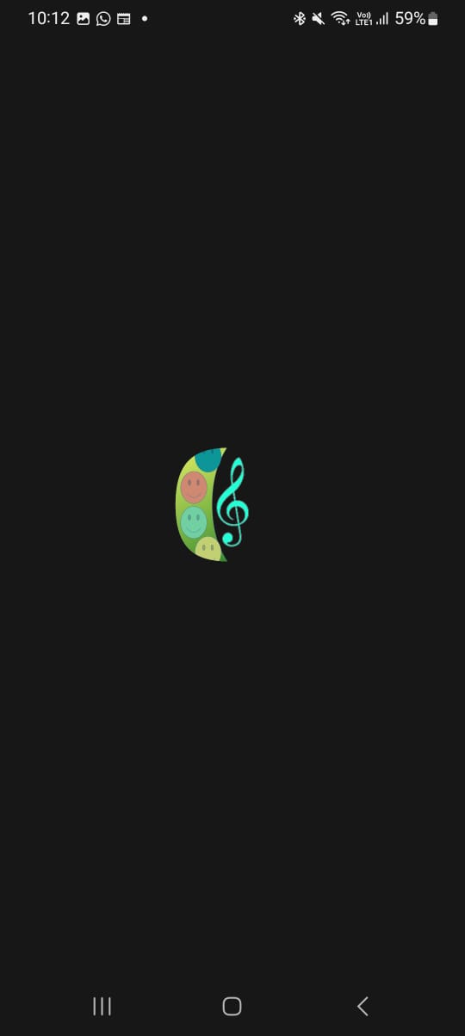
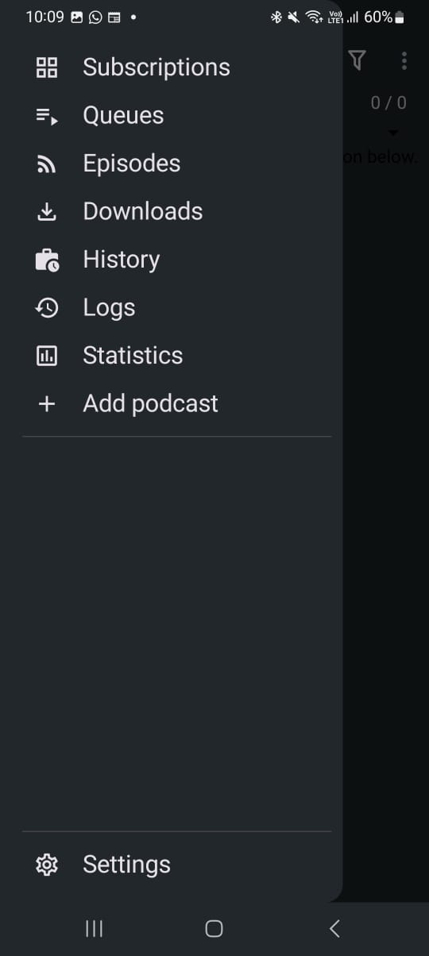
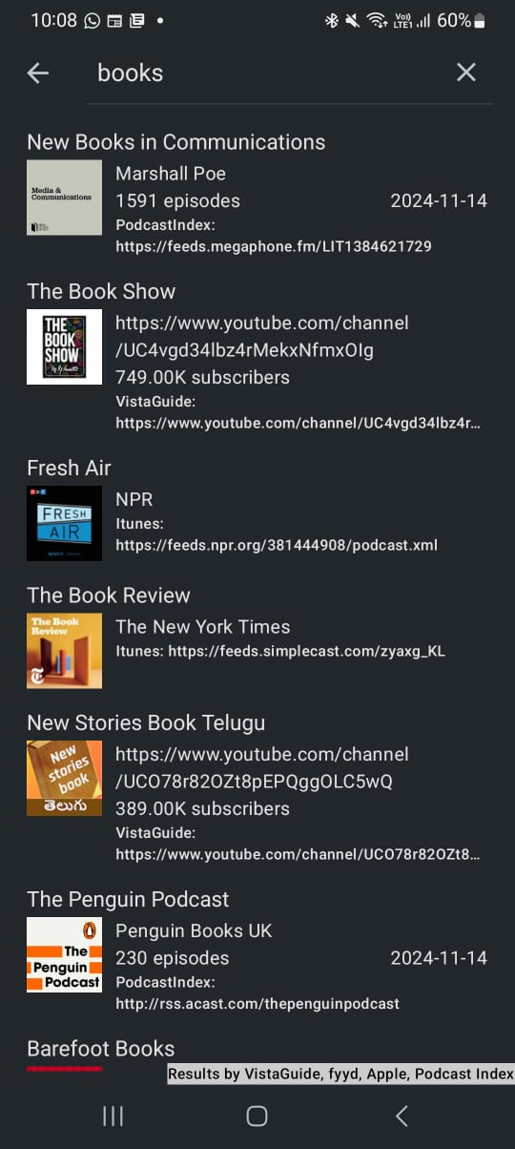
OUTPUT:

Slide 18
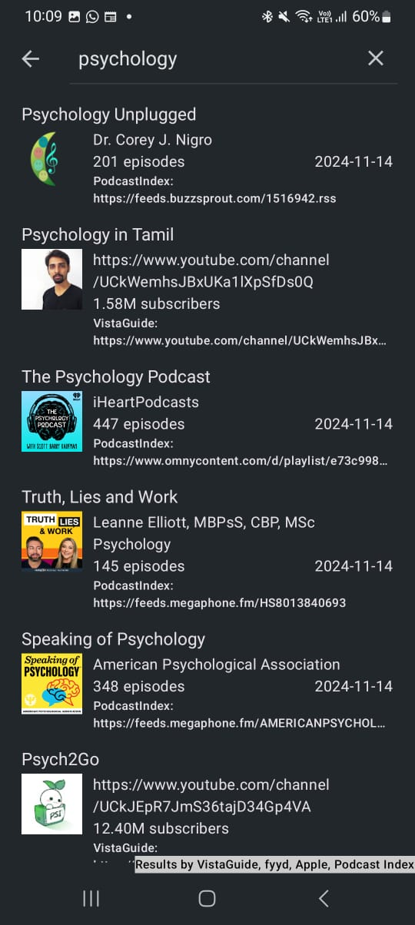
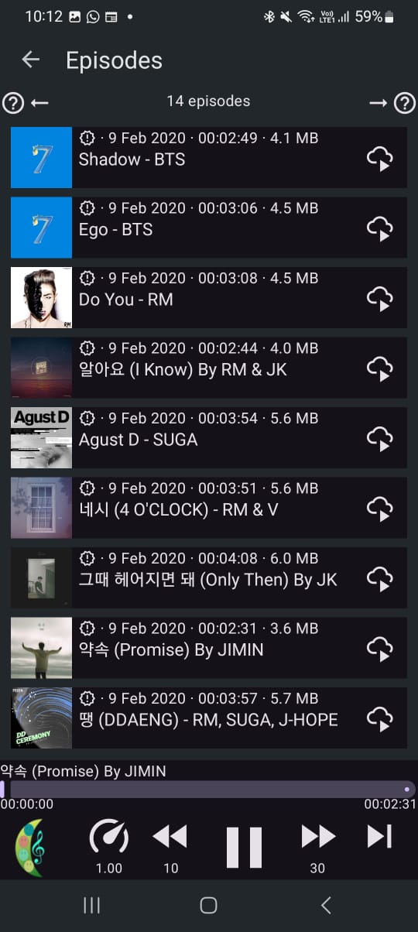
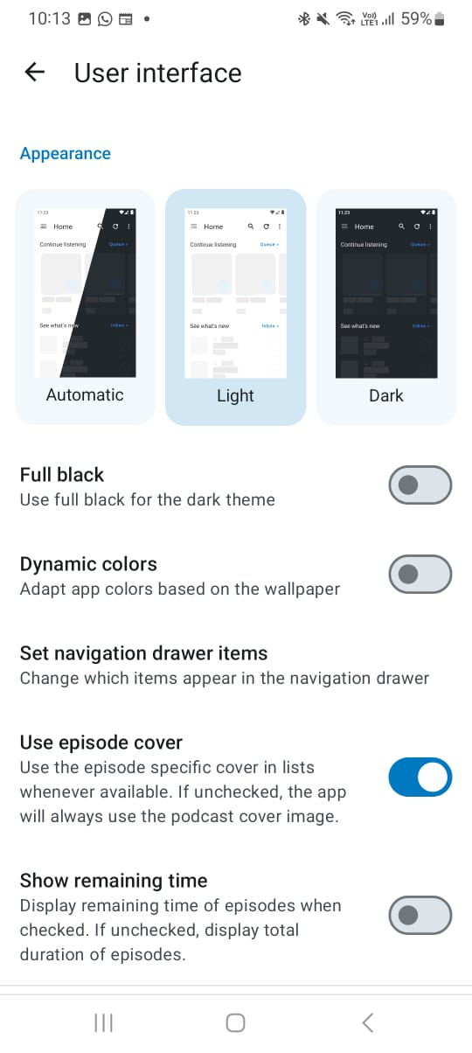

Slide 19
